Slide 1



Cultural Considerations in
Early Psychosis Management
G. Eric Jarvis, MD, MSc, FRCP
Professor of Psychiatry
Division of Social & Transcultural Psychiatry
McGill University

Slide 2

Welcome
Diane Fredrikson, BSc, MD, FRCPC
Clinical Instructor, UBC Department of Psychiatry Director
Director, Continuing Professional Development
UBC Department of Psychiatry
Vancouver, BC

Slide 3






Thank you!
Support for this program provided in part by the following companies through an educational grant:

Slide 4

Housekeeping
If you require technical support, please click the “Tech Support” button on the top right of your screen.
To submit a question please use the “Q&A” button located under the chat. Questions will be addressed during the Q&A portion following the presentation.
Following the presentation, you will be provided with a link to a short evaluation survey.

Slide 5


EPI Canada
The Canadian Consortium for Early Intervention in Psychosis
EPI Canada is a national, not-for-profit organization of clinicians and researchers dedicated to improving the quality of care for individuals in early phase psychosis.
Notes:
Speaker Notes:
Missing membership in the northwest territories, and PEI

Slide 6



How To Find Us
www.epicanada.org
@EPI_Canada
epi-canada

Slide 7

Today’s Presenter
Welcome from the CCEIP
G. Eric Jarvis, MD, MSc, FRCP
Professor of Psychiatry
Division of Social & Transcultural Psychiatry
McGill University

Slide 8

Cultural considerations in early psychosis management
G. Eric Jarvis, MD
Division of Social & Transcultural Psychiatry
McGill University
November 7, 2025

Slide 9
Land acknowledgment
We acknowledge that we live, work, play and meet, on the territories of Indigenous Peoples across Turtle Island, now called Canada…We recognize the importance of honouring the past, acknowledging the present, and working towards a future that embraces reconciliation and respect for Indigenous Peoples (Canadian Paralympic Committee 2025)

Slide 10

Disclosures
Nothing to disclose

Slide 11
Objectives
To understand the role of culture in the development of psychosis
To learn how culture influences the expression of psychotic symptoms
To become familiar with cultural interventions for psychosis

Slide 12
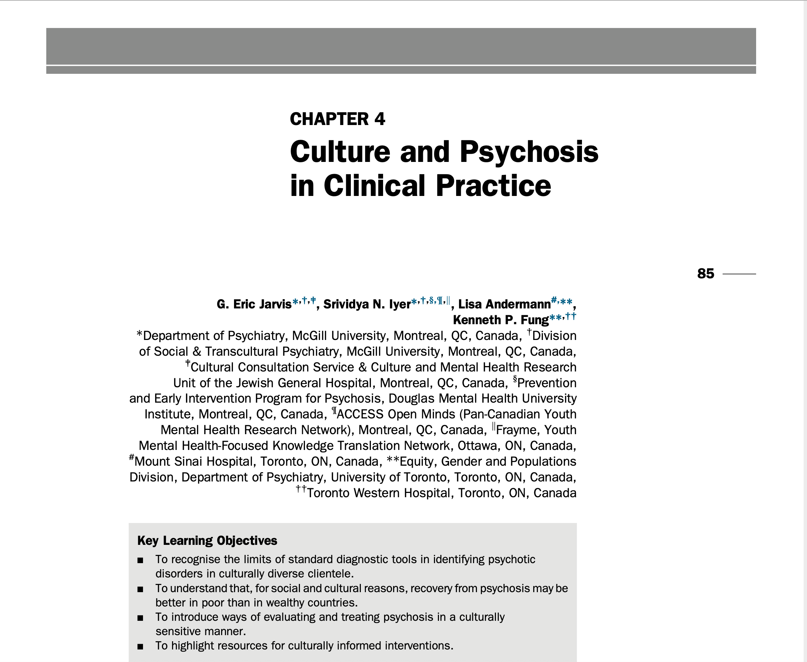
Book Chapter
Year 2020

Slide 13
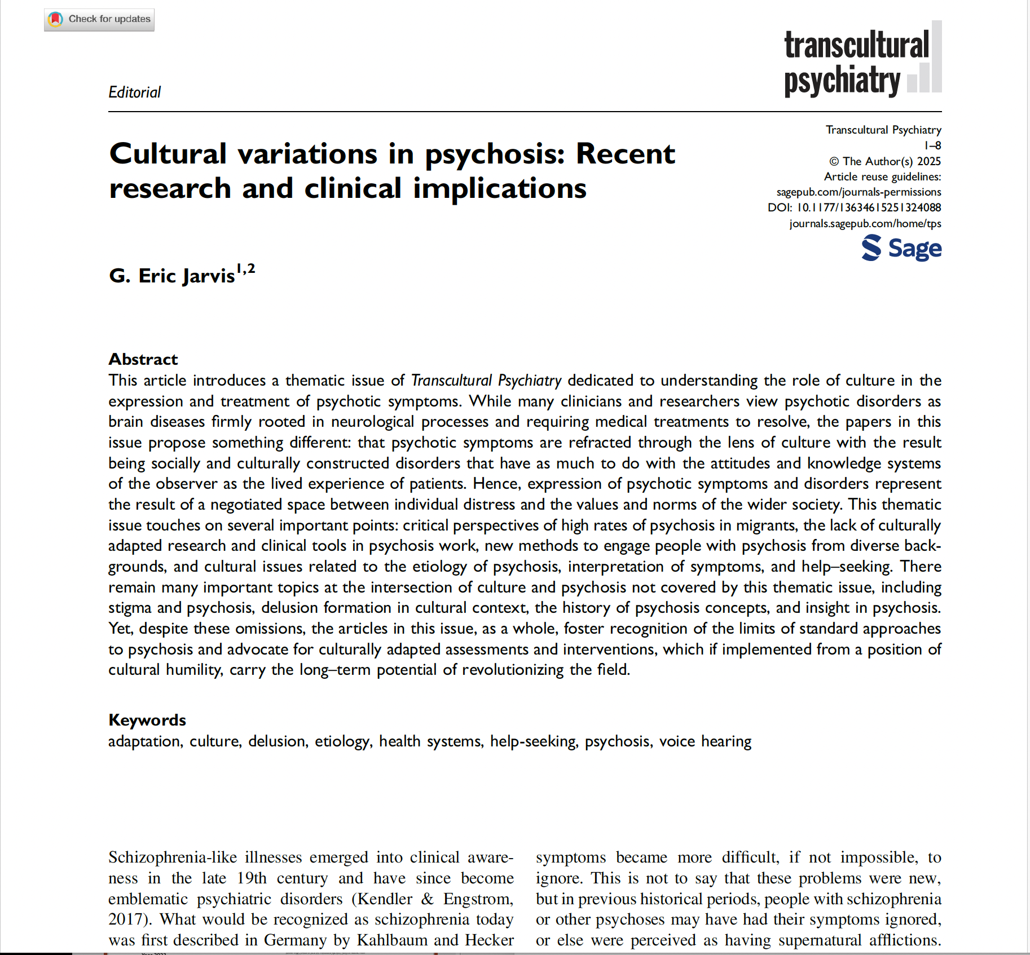
Cultural variations in psychosis
Year 2025

Slide 14

Schizophrenia as a recent illness
In 1871, Kahlbaum & Hecker described the first clinical description of what could now be called schizophrenia and with the claim that it represented a distinct disease (Shorter, p. 104)
Hare (1988) suggested that schizophrenia is a relatively recent illness, appearing first in the Western world in the 19th century and then gradually becoming more common elsewhere over the course of the 20th century

Slide 15
Historicity of schizophrenia
1896
Kraepelin
Dementia praecox, deficit symptoms
1911
Bleuler
Schizophrenias characterized by autism and disturbance of affect
1943
Kanner
Autism as an independent disorder of childhood
1958
Schneider
First rank symptoms characterize schizophrenia
1974
Strauss
1871
Kahlbaum & Hecker
Cases of insidious onset psychosis
Negative symptoms

Slide 16
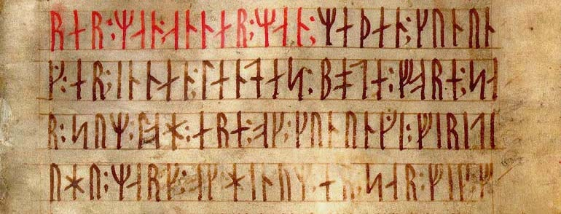
Taking a cultural psychiatry perspective

Slide 17
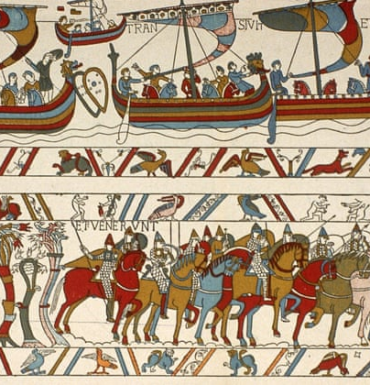
Culture
The great reservoir of habits, constraints, accumulated lore, accepted practice and statements which may seem, to the individual, personal and spontaneous, but which have really been handed down from a great distance…as much our inheritance as the language we speak
  Fernand Braudel, 1982
A system of beliefs and practices that is taken-for-granted by some population
  Allan Young, 2015

Slide 18
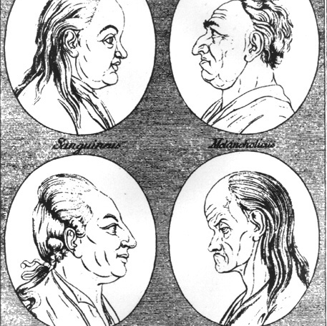
Cultures of psychiatry
The notion of culture is sometimes extended to speak of various subcultures or the cultures of professions. In this sense, we can speak of the cultures of biomedicine and of psychiatry (Kirmayer et al., 2003, p. 20)

Slide 19

Culture and the onset of psychosis
Rates
Diagnosis
Causal attributions
Role for racism and discrimination

Slide 20

WHO studies (DOSMeD 1992)
The annual incidence of broadly defined schizophrenia was 1.5 (Denmark) to 4.2 (rural India) per 10,000 (a significant difference)
The rates of narrowly defined schizophrenia were similar across study sites (0.7 to 1.4/10,000)
Outcome for narrowly defined schizophrenia was better in developing than developed sites

Slide 21
Legacy of WHO Studies
Country | Legacy
U.K. | Full adoption of WHO methods and rationale in the home country for studying migrant populations with exportation to Scandinavia, Israel, The Netherlands, Caribbean countries and several countries in Europe participating in the EU-GEI
U.S. | Although participating initially, WHO methods were abandoned in favor of smaller-scale studies examining diagnostic bias in clinical settings; recent trends may be favoring a high rates discourse based on racial discrimination rather than migration as the key driver of high rates of psychosis and schizophrenia in African Americans
France | This was an Anglo-American project that was born of decolonization and was the successor to British ethnopsychiatry in the former colonies

Slide 22

Etiology
  From INTREPID: Concepts of madness in diverse settings (Cohen et al 2016)
  Supernatural
    -black magic, spells, demonic possession, susceptibility to wandering spirits or possession
  Psychological and social
    -thinking too much, family problems, shock
  Biological
    -family inheritance, brain injury
  Substance use
  Multiple causes

Slide 23
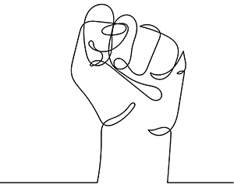
Racism and psychosis (Francis-Crossley et al., 2025)
The findings from our review indicate a relationship between racial/ethnic discrimination and psychosis. This potentially supports theories about the pernicious role that racism plays in explaining a substantial portion of the large ethnic disparities observed in psychosis risk that have been consistently observed in many marginalised ethnic and migrant groups for over 170 years

Slide 24

Cultural expression of psychosis:
Hallucinations
Delusions
Negative symptoms

Slide 25
Culture and hallucinations
Cultures can sanction or stigmatize hallucinations
  -Hallucinations are common in nonclinical populations (up to 90% prevalence depending on the group and study)
  -Euro-American cultures may reduce the overall rate of reported hallucinations
  -Auditory-verbal hallucinations have come to be equated with psychosis and schizophrenia in psychiatry (see Evrard et al 2024)
  -Culture may make hallucinations more or less sinister (see Luhrmann et al 2015)
Hallucinations may be due to trauma, PTSD and dissociation rather than psychotic disorder
Hallucinations that are not culturally consonant tend to be bizarre, unpleasant, or terrifying
Hallucinations related to psychotic disorder may be culturally meaningful (and often are) (Larøi et al 2014)

Slide 26
Culture and delusions
Overvalued ideas (like in the case of Breivik in 2011)
  -Non-delusional, strongly held beliefs (Rahman, Resnick & Harry 2016)
Up to 15% of nonclinical populations may have delusional ideation (Freeman 2006), while 39% have delusion-like beliefs (Pechey & Halligan 2011)
Cultural beliefs may be mistaken for delusions
Symptoms related to trauma and PTSD may appear to be delusional
Delusional material that is not culturally consonant tends to be bizarre, unpleasant, secretive, self-preoccupied, or terrifying

Slide 27
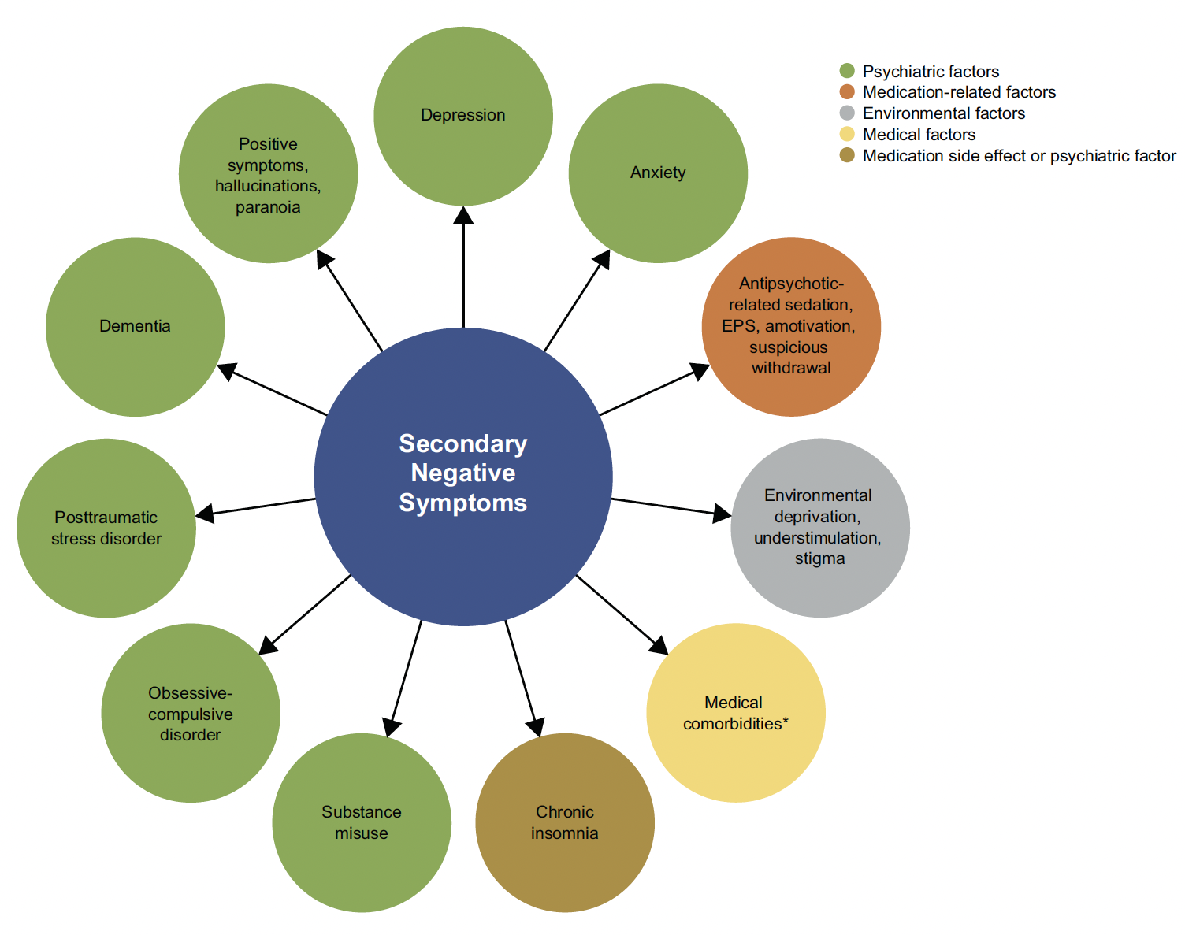
Causes of negative symptoms
(Correll & Schooler, 2020)

Slide 28

Negative Symptoms in Cultural Context
Social adversity may explain or contribute to apparent negative symptoms in members of racialized communities:
“Thus, after experiencing the illness for many years, it is possible that indirect environmental factors (economy, mass media, politics, government laws)…begin to exert a greater effect on their ability to perform recreational, goal-directed, and social activities that are the foundation of negative symptoms”
(Strauss, 2024, p. 1173)

Slide 29

Cultural interventions for psychosis

Slide 30

Culture affects all aspects of management
Pathways to care
Reducing discriminatory practices and policies
Diagnosis – Attention to trauma history and religious interpretation of symptoms
Addressing cultural beliefs and practices in the treatment of psychosis
Tailoring recovery to cultural context
Cultural adaptation of services

Slide 31
Attention to diagnosis (Adeponle et al 2012)
A total of 34 (49%) of the 70 cases with an intake (referral) diagnosis of a psychotic disorder were rediagnosed as nonpsychotic disorders
Only 12 (5%) of the 253 cases with an intake diagnosis of a nonpsychotic disorder were rediagnosed as a psychotic disorder (p<.001)
Major depression, posttraumatic stress disorder (PTSD), adjustment disorder, and bipolar affective disorder were the common disorders diagnosed with use of the cultural formulation
Rediagnosis of a psychotic disorder as a nonpsychotic disorder was significantly associated with being a recent arrival in Canada (odds ratio [OR]=6.05, 95% confidence interval [CI]=1.56-23.46, p=.009), being nonblack (OR=3.72, CI=1.03-13.41, p=.045), and being referred to the CCS by nonmedical routes (such as social work or occupational therapy) (OR=3.23, CI=1.03-10.13, p=.044)

Slide 32
Culturally adapted interventions
Are more effective than standard interventions
Reduce symptoms
Include components such as
-translated materials
-use of specific phrases and metaphors
-logistical modifications
-regard for religion/spirituality, family factors, and culture specific communication styles
    (Edge et al 2016; Lal et al 2018; Oluwoye et al 2020; Husain et al 2023)

Slide 33
Caution
“…practitioners should always evaluate whether psychotic-like experiences may be better explained via ethno-cultural context” (Rogers et al., 2024, p. 221)

Slide 34
How?
  Cultural safety: recognizing power imbalances in the clinical encounter and creating a safe space where patients with historical legacies of trauma can openly discuss their problems (Williams, 1999)
  Cultural humility: clinician recognizing the limits of their cultural knowledge; and therefore seeking inputs from patients, families, community members and interpreters; and modifying standard mental health practices accordingly (Tervalon & Murray-Garcia, 1998)
  Linguistic interpreters
  Culture brokers
  Outline for Cultural Formulation (OCF)
  Cultural Formulation Interview (CFI)

Slide 35
Cultural Consultation
  The Cultural Consultation Service (CCS) offers in depth mental health evaluation of immigrants and refugees
  Employs linguistic and cultural interpreters, a person-centered approach, and principles of cultural safety and humility (Kirmayer et al 2008,2023)
  From 1 to 3 evaluative sessions clarify the concerns of referring clinicians
  A clinical case conference finalizes each case and offers an occasion for the referring clinical team to give and receive input regarding the particular cultural dilemmas they are facing
  The CCS model has been exported to several sites, mostly in Europe and North America
  The CCS initiated the International Consortium for Cultural Consultation (ICCC) to monitor the progress of and improve networking among various participating clinics

Slide 36
An invitation
We need to break away from some of our familiar practices and comfortable ways of thinking to put culture at the forefront of our work with psychotic patients

Slide 37
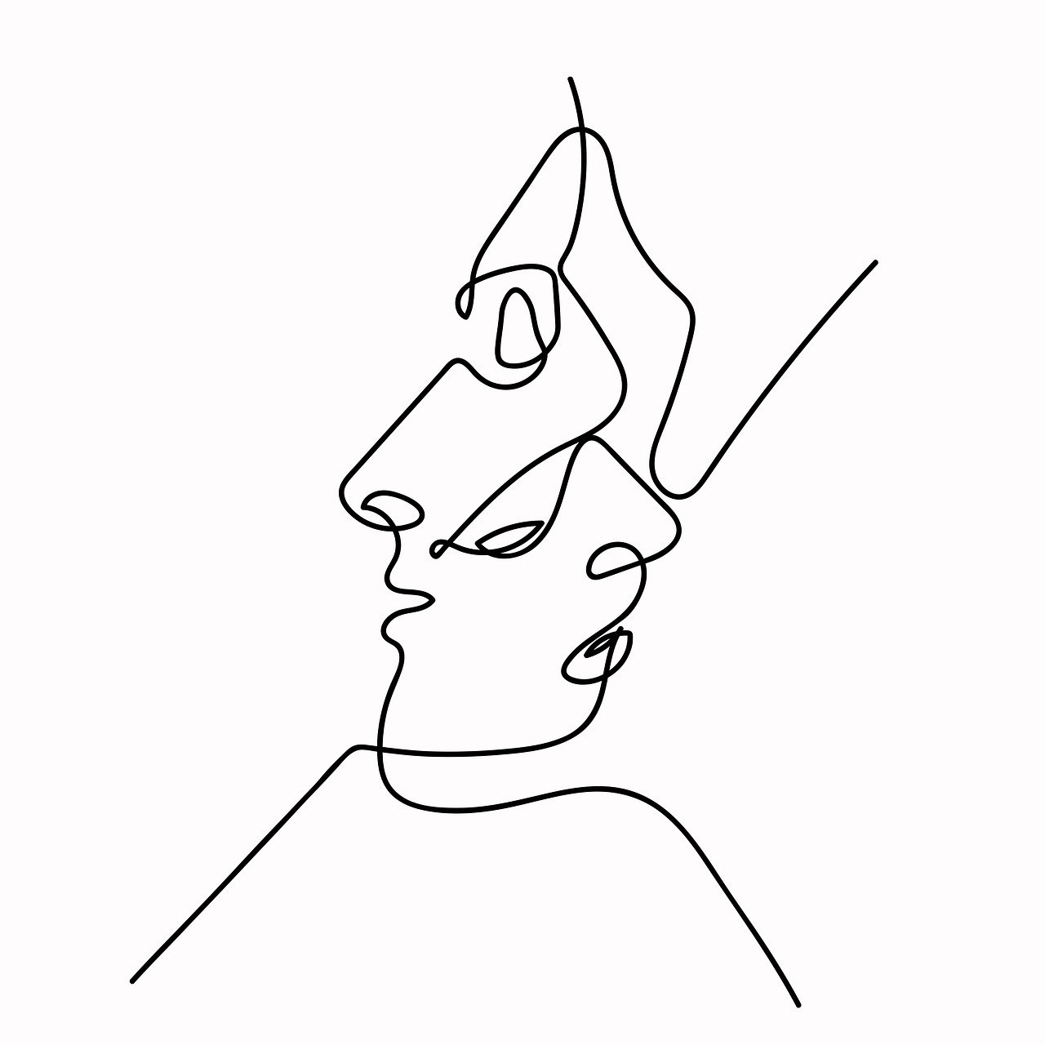
Case example

Slide 38
Depression versus
Negative Symptoms
18-year-old African Canadian man
Possible FEP in 2020, with auditory and tactile hallucinations, emotional blunting, avolition, paranoia for one year – then no symptoms for three years
No current medication or substance use
Psychiatric evaluation in Dec 2023 – “recurrent depression but not currently depressed”
“However, through multiple subsequent individual psychotherapy sessions, [we] strongly believe that the patient would benefit from an in-depth evaluation…to r/o psychosis due to persistent negative/cognitive psychotic symptoms.”

Slide 39
Specific concerns of the clinical team
“Since 2020 he began experiencing restricted affect, less ability and desire to communicate with others, and less anticipatory pleasure about things that he used to look forward to. As a result, he has found it harder to maintain relationships with others. He has also found it more difficult to feel attraction and romantic interest towards others.”

Slide 40
Specific concerns of the clinical team
“We would appreciate your expert assessment…to help determine if there is enough evidence to appropriately consider that he suffered a psychotic period and may continue to struggle with the negative symptoms of schizophrenia.”
Clinical decision: No psychosis present and referral to youth services for follow up – may refer again to early psychosis services if psychotic symptoms become clear

Slide 41
Cultural considerations in early psychosis management
Understand the role of culture in the development of psychosis
Learn how culture influences the expression of psychotic symptoms
Become familiar with cultural interventions for psychosis

Slide 42
Contact information
G. Eric Jarvis, MD, eric.jarvis@mcgill.ca
Cultural Consultation Service, Antonella Clerici, 514-340-8222 ext 25655, ￼￼antonella.clerici@affiliate.mcgill.ca

Slide 43
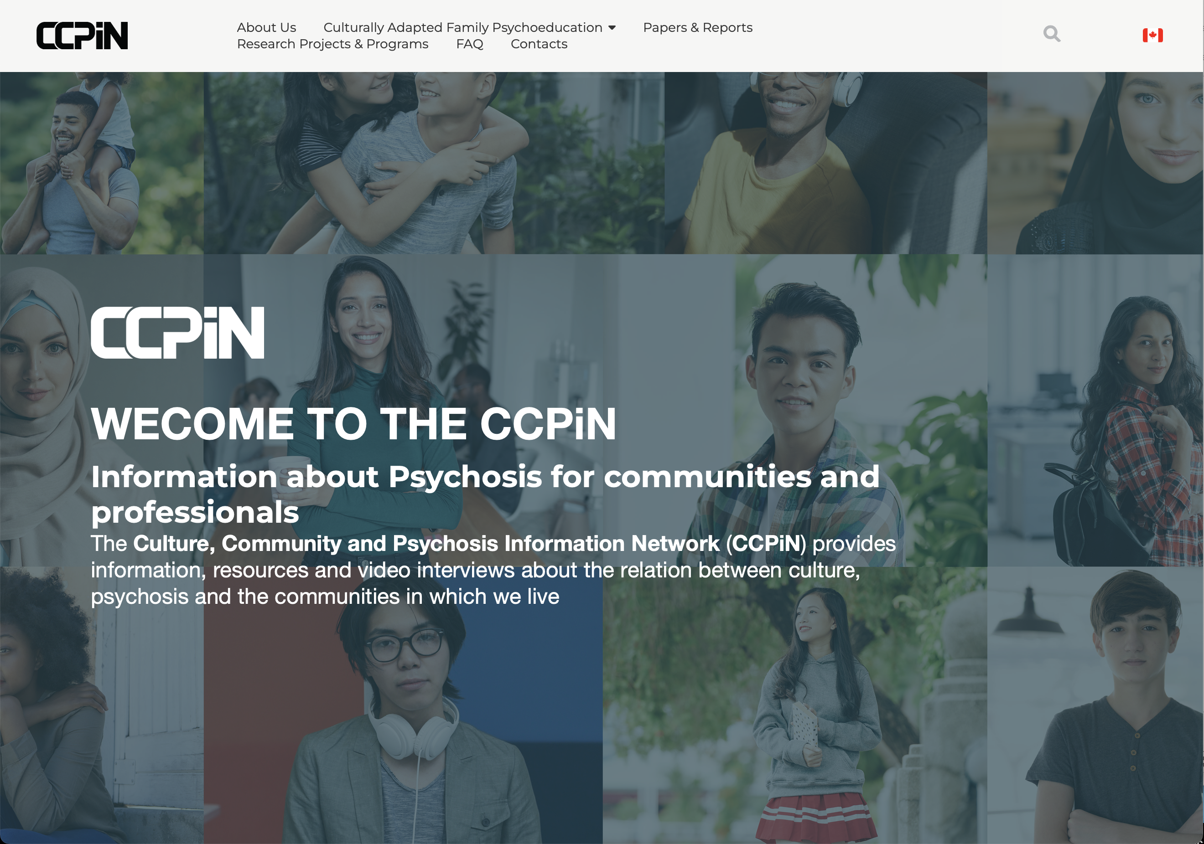

Slide 44
References – page 1
Adeponle AB, Thombs BD, Groleau D, Jarvis E, Kirmayer LJ. Using the cultural formulation to resolve uncertainty in diagnoses of psychosis among ethnoculturally diverse patients. Psychiatr Serv. 2012 Feb 1;63(2):147-53. doi: 10.1176/appi.ps.201100280. PMID: 22302332.
Anglin DM. Racism and Social Determinants of Psychosis. Annu Rev Clin Psychol. 2023 May 9;19:277-302. doi: 10.1146/annurev-clinpsy-080921-074730. Epub 2023 Mar 8. PMID: 36888999.
Braudel, F. (1982). The Wheels of Commerce. Harper & Row: New York.
Cohen A, Padmavati R, Hibben M, Oyewusi S, John S, Esan O, Patel V, Weiss H, Murray R, Hutchinson G, Gureje O, Thara R, Morgan C. Concepts of madness in diverse settings: a qualitative study from the INTREPID project. BMC Psychiatry. 2016 Nov 9;16(1):388. doi: 10.1186/s12888-016-1090-4. PMID: 27829384; PMCID: PMC5103598.
Correll CU, Schooler NR. Negative Symptoms in Schizophrenia: A Review and Clinical Guide for Recognition, Assessment, and Treatment. Neuropsychiatr Dis Treat. 2020 Feb 21;16:519-534. doi: 10.2147/NDT.S225643. PMID: 32110026; PMCID: PMC7041437.
Evrard R, Beauvais B, Essadek A, Lighezzolo-Alnot J, Clesse C. (2024). Neither saintly nor psychotic: a narrative systematic review of the evolving Western perception of voice hearing. History of Psychiatry. 35(2):177-195. doi:10.1177/0957154X1231690.
Francis-Crossley I, Hudson G, Harris L, Onwumere J, Kirkbride JB (2025) The association between racism and psychosis: An umbrella review. PLOS Ment Health 2(9): e0000401. https://doi.org/10.1371/journal.pmen.0000401.
Freeman, D. Delusions in the nonclinical population. Curr Psychiatry Rep 8, 191–204 (2006). https://doi.org/10.1007/s11920-006-0023-1.
Hacking, I. (1995). The looping effects of human kinds. In D. Sperber, D. Premack, & A. J. Premack (Eds.), Causal cognition: A multidisciplinary debate (pp. 351–394). Clarendon Press/Oxford University Press.

Slide 45
References – page 2
Hacking, Ian (1999). The social construction of what?. Cambridge, Mass: Harvard University Press.
Hare E. Schizophrenia as a recent disease. Br J Psychiatry. 1988 Oct;153:521-31. doi: 10.1192/bjp.153.4.521. PMID: 3074859.
Husain, M. O., Khoso, A. B., Kiran, T., Chaudhry, N., Husain, M. I., Asif, M., ... & Chaudhry, I. B. (2023). Culturally adapted psychosocial interventions (CaPSI) for early psychosis in a low-resource setting: study protocol for a large multi-center RCT. BMC psychiatry, 23(1), 444.
Jablensky A, Sartorius N, Ernberg G, Anker M, Korten A, Cooper JE, Day R, Bertelsen A. Schizophrenia: manifestations, incidence and course in different cultures. A World Health Organization ten-country study. Psychol Med Monogr Suppl. 1992;20:1-97. doi: 10.1017/s0264180100000904. Erratum in: Psychol Med Monogr Suppl 1992 Nov;22(4):following 1092. PMID: 1565705.Edge D, Degnan A, Cotterill S, Berry K, Drake R, Baker J, Barrowclough C, Hughes-Morley A, Grey P, Bhugra D, Cahoon P, Tarrier N, Lewis S, & Abel K. (2016). Culturally-adapted Family Intervention (CaFI) for African-Caribbeans diagnosed with schizophrenia and their families: a feasibility study protocol of implementation and acceptability. Pilot Feasibility Stud 2, 39.https://doi.org/10.1186/s40814-016-0070-2.
Jarvis, G. E., Iyer, S. N., Andermann, L., & Fung, K. P. (2020). Culture and psychosis in clinical practice. In J. C. Badcock & G. Paulik (Eds.), A clinical introduction to psychosis: Foundations for clinical psychologists and neuropsychologists (pp. 85–112). Elsevier Academic Press. https://doi.org/10.1016/B978-0-12-815012-2.00004-3
Jarvis, G., & Kirmayer, L. (2021, March 25). Situating Mental Disorders in Cultural Frames. Oxford Research Encyclopedia of Psychology. Retrieved 7 Nov. 2025, from https://oxfordre.com/psychology/view/10.1093/acrefore/9780190236557.001.0001/acrefore-9780190236557-e-627.
Jarvis GE. Cultural variations in psychosis: Recent research and clinical implications. Transcultural Psychiatry. 2025;62(1):3-10.
Kirmayer LJ, Groleau D, Guzder J, Blake C, Jarvis E. Cultural consultation: a model of mental health service for multicultural societies. Can J Psychiatry. 2003 Apr;48(3):145-53. doi: 10.1177/070674370304800302. PMID: 12728738.
Kirmayer, LJ, Rousseau, C, Jarvis, GE, & Guzder, J. (2008, 2023). The Cultural Context of Clinical Assessment. A Tasman, MB Riba, TG Schulze, CH Ng, CA Alfonso, D Lecic-Tosevski, S Kanba, RD Alarcón, & D Ndetei. Psychiatry. Fifth Edition: 2-25. Springer Nature, Switzerland.
Kleinman, AM. (1977). Depression, somatization and the “new cross-cultural psychiatry”. Social Science and Medicine, 11(1), 3-9. https://doi.org/10.1016/0037-7856(77)90138-X.

Slide 46
References – page 3
.
Kleinman, AM (1988). Rethining Psychiatry: From Cultural Category to Personal Experience. Free Press (Macmillan Publishing Co: New York.
Lal, S., Gleeson, J., Malla, A., Rivard, L., Joober, R., Chandrasena, R., & Alvarez-Jimenez, M. (2018). Cultural and contextual adaptation of an ehealth intervention for youth receiving services for first-episode psychosis: adaptation framework and protocol for Horyzons-Canada phase 1. JMIR Research Protocols, 7(4), e8810.
Larøi F, Luhrmann TM, Bell V, Christian WA Jr, Deshpande S, Fernyhough C, Jenkins J, Woods A. Culture and hallucinations: overview and future directions. Schizophr Bull. 2014 Jul;40 Suppl 4(Suppl 4):S213-20. doi: 10.1093/schbul/sbu012. PMID: 24936082; PMCID: PMC4141319.
Luhrmann TM, Padmavati R, Tharoor H, Osei A. Differences in voice-hearing experiences of people with psychosis in the U.S.A., India and Ghana: interview-based study. Br J Psychiatry. 2015 Jan;206(1):41-4. doi: 10.1192/bjp.bp.113.139048. Epub 2014 Jun 26. PMID: 24970772.
Oluwoye, O., Dyck, D., McPherson, S. M., Lewis-Fernández, R., Compton, M. T., McDonell, M. G., & Cabassa, L. J. (2020). Developing and implementing a culturally informed FAmily Motivational Engagement Strategy (FAMES) to increase family engagement in first episode psychosis programs: mixed methods pilot study protocol. BMJ open, 10(8), e036907
Pechey R, Halligan P. The prevalence of delusion-like beliefs relative to sociocultural beliefs in the general population. Psychopathology. 2011;44(2):106-15. doi: 10.1159/000319788. Epub 2010 Dec 24. PMID: 21196811.
Rahman T, Resnick PJ, Harry B. Anders Breivik: Extreme Beliefs Mistaken for Psychosis. J Am Acad Psychiatry Law. 2016 Mar;44(1):28-35. PMID: 26944741.
Rogers, R, Correa, AA, & Ryan-Jones, LD. (2024). Forensic Assessments of Racial-Ethnic Differences in Genuine and Malingered Psychotic Presentations. J Am Acad Psychiatry Law; 52:216-24.
Shorter, E. (1997). A history of psychiatry: From the era of the asylum to the age of Prozac. John Wiley & Sons.
Tervalon M, Murray-García J. Cultural humility versus cultural competence: a critical distinction in defining physician training outcomes in multicultural education. J Health Care Poor Underserved. 1998 May;9(2):117-25. doi: 10.1353/hpu.2010.0233. PMID: 10073197.
Willilams, R. (1999). Cultural safety – what does it mean for our work practice? Australian and New Zealand Journal of Public Health, 23(2):213-214.
Young, A. (2015). Personal Communication, McGill Diploma Course.

Slide 47
Q&A

Slide 48
Evaluation
Please click the link in the chat, or below your video player, to access the short evaluation survey.
Your feedback is so valuable!

